Slide 1
THE DIGITAL REVOLUTION:
A BLESSING OR A CURSE?

Slide 2
Technology has major consequences in our life
In today’s fast paced world,technology plays a major role in our everyday life,and within a few years from now,our social life will become totally dependant on it. Technology has done wonders to make our lives easy but have we ever thought what impact it can have on human relations ? Let’s have a look at the pros and the cons.

Slide 3
Advantages
*First of all, our devices and their connectivity matter to us right up there with food and shelter
*Technology has altered the flow of time
*We all know that the Internet has shrunk space as well as time
*Knowledge from anywhere is in our hand
*Our past is saved in our devices

Slide 4
Advantages
Our digital now is not the present but is always a few seconds ahead
Choice is freedom
Access to education
Free Internet courses for all levels of education
People learn on their own by games,online tutorials,youtube etc.

Slide 5
Advantages
Education is online and free
You can find famous people and their voices on the net
The logic of digital culture is the culture of everything
Improves housing and lifestyle
Convenience of travelling and working
Change of health industry
Encourages innovation and creativity
NOT EVERYTHING IS BAD ABOUT TECHNOLOGY AND ELECTRONICS. WE JUST HAVE TO REMEMBER NOT TO LET THEM TAKE OVER OUR LIVES!

Slide 6
Disadvantages
Job loss – replacing humans?
World destruction weapons – increasing endless wars?
Increased loneliness – social isolation?
Competency – increased dependency on modern tools that reduces our creativity and intelligence.

Slide 7
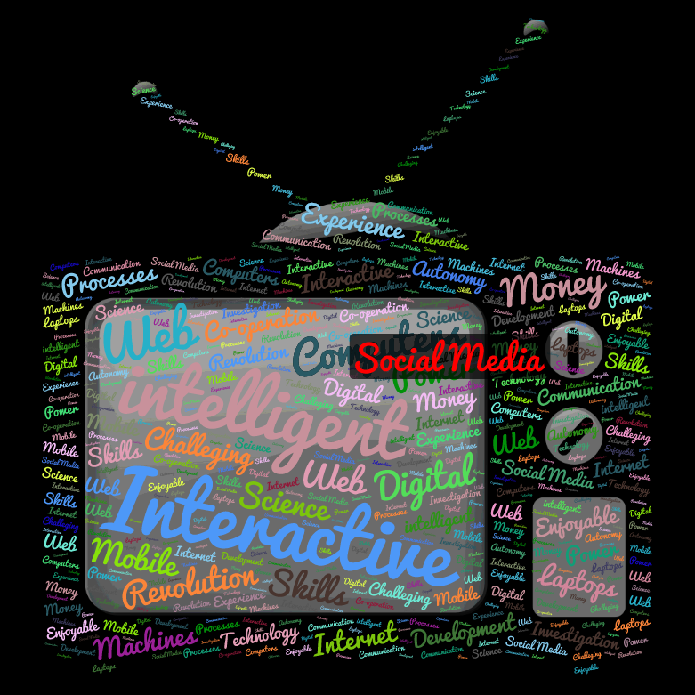
The word-art our team created

Slide 8
The comic our team created
Where have you been?

Slide 9
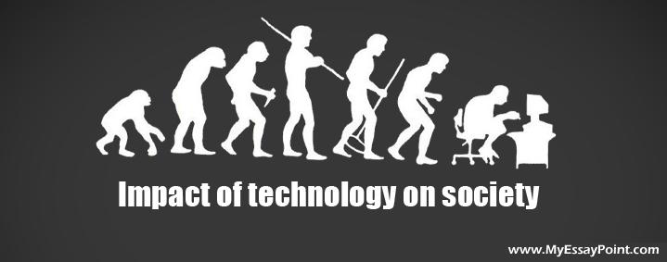

Slide 10
ΔΗΜΙΟΥΡΓΙΚΕΣ ΕΡΓΑΣΙΕΣ 2017
ΜΑΘΗΜΑ:ΑΓΓΛΙΚΑ
ΘΕΜΑ: THE DIGITAL REVOLUTION
ΟΜΑΔΑ:
ΒΑΣΙΛΙΚΗ ΚΟΥΤΡΟΥΜΑΝΗ
ΓΙΩΡΓΟΣ ΧΑΤΙΝΟΓΛΟΥ
ΓΙΩΡΓΟΣ ΔΡΙΒΑΣ ΥΠΕΥΘΥΝΗ ΚΑΘΗΓΗΤΡΙΑ: Ε. ΚΟΥΤΣΟΥΜΠΟΥ

